Slide 1

Career Guidance Management System

Slide 2

Supervisor
Ms. Divya Singhal
Team Members
Akarsh Mishra (Team Leader)
Akanksha Mangal
Group No. GB02

Slide 3


Introduction :
Graduation marks the end of college, leaving many students uncertain about their future.
Choosing a career path, especially in fields like Engineering, can be challenging due to the multitude of options.
It's crucial for students to assess their capabilities and identify their interests while in college to clarify their career goals.
Proposed idea: ML-based "Career Guidance System" to assist students, especially in their pre-final and final years, in determining suitable job roles based on their performance and evaluations.

Slide 4
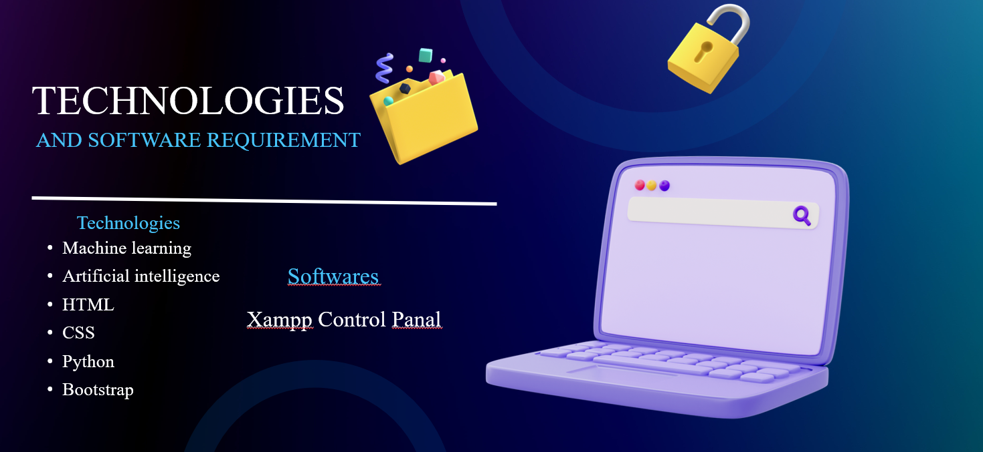

Slide 5

Hardware Requirements
Processor: Intel Core i5 or equivalent
RAM: Minimum 8GB
Storage: SSD
Network Interface: Gigabit Ethernet

Slide 6
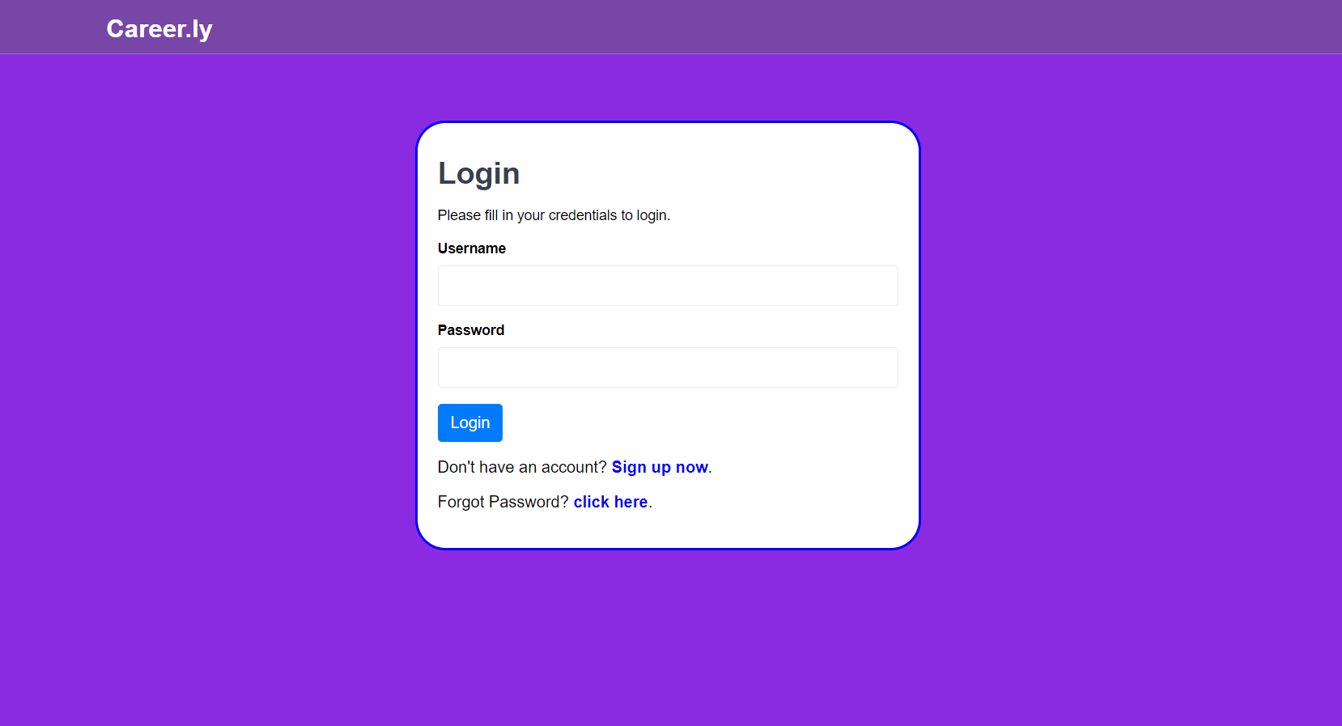
Login

Slide 7
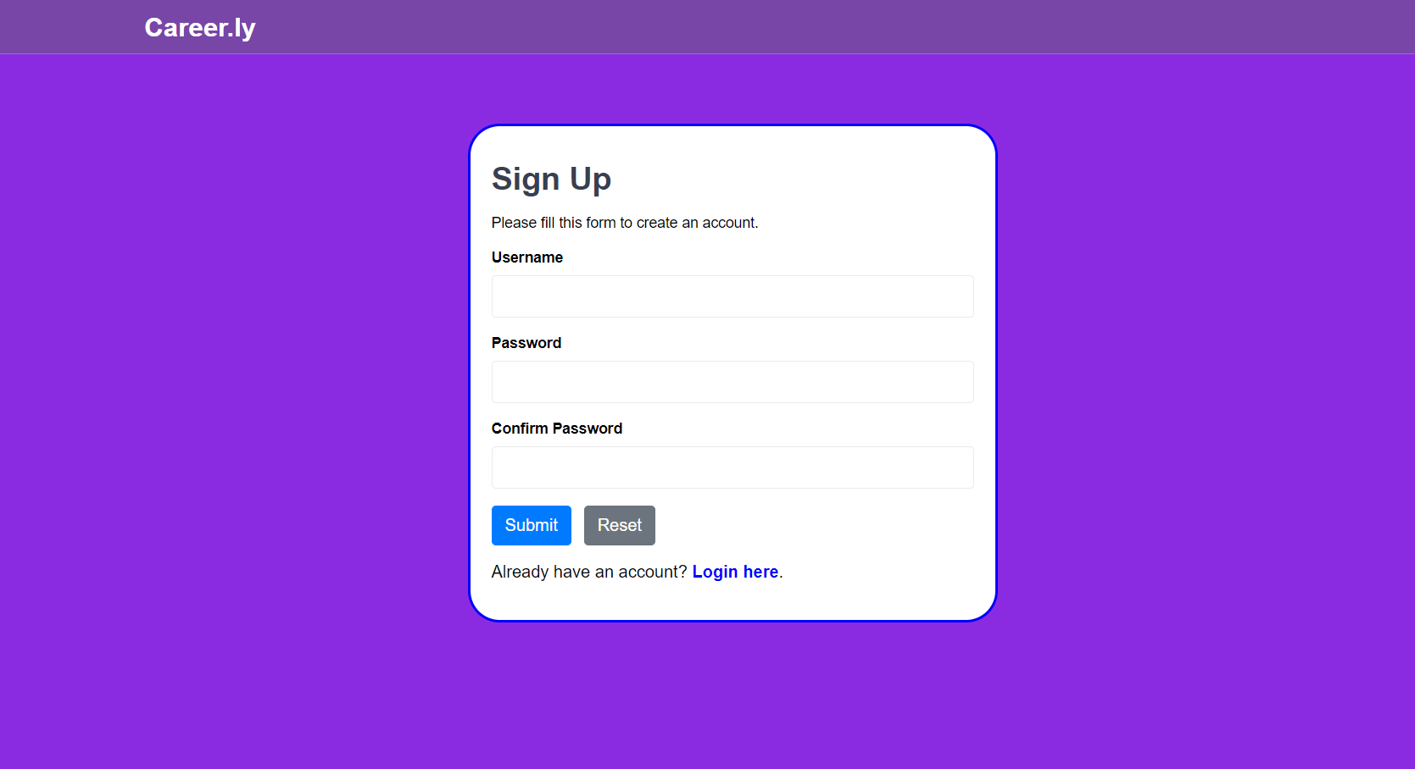
Sign Up

Slide 8
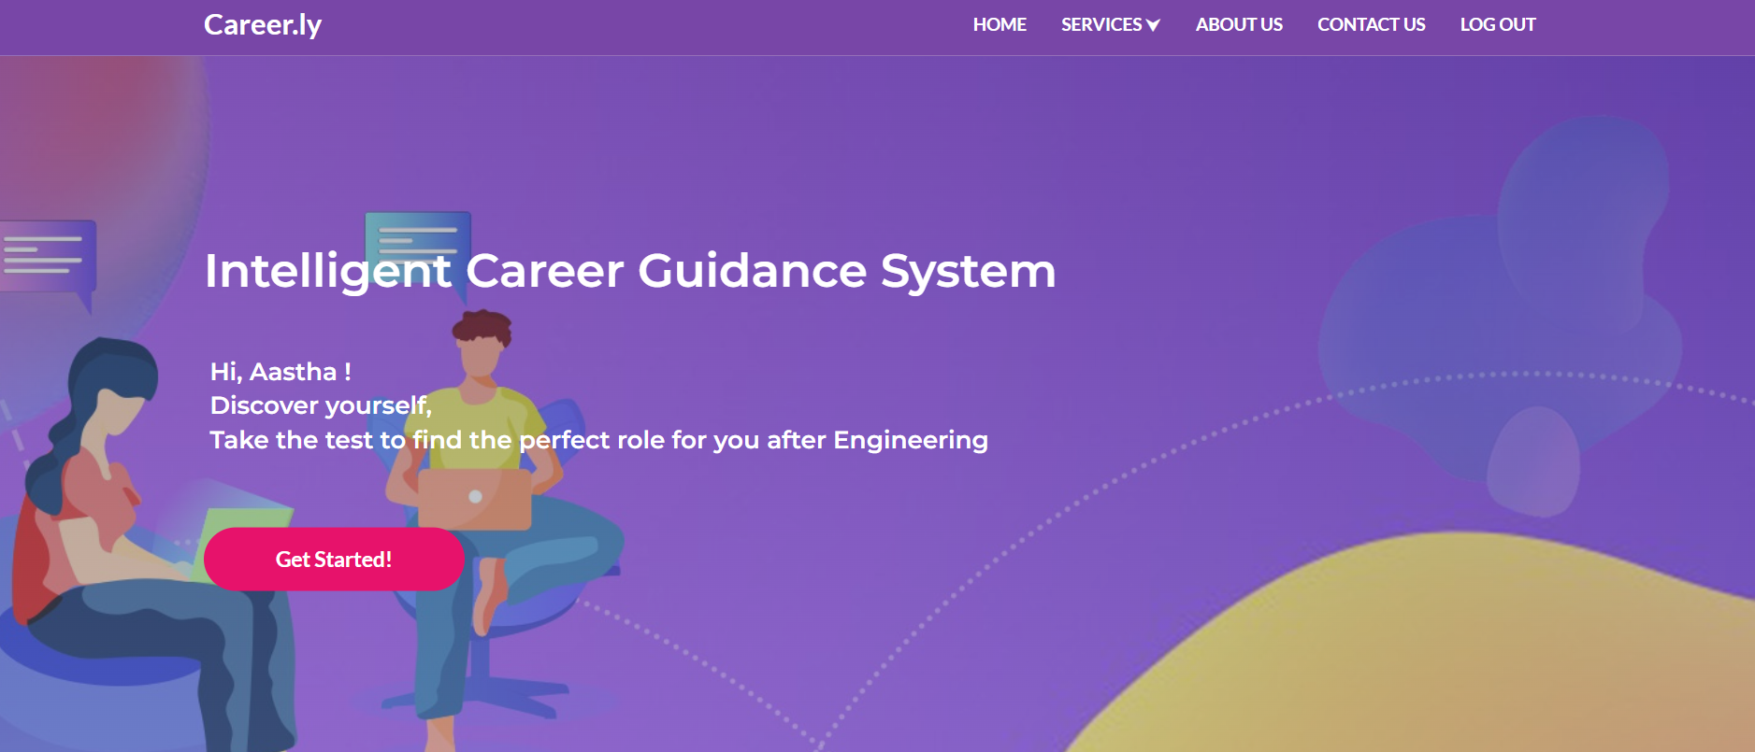
Main View

Slide 9
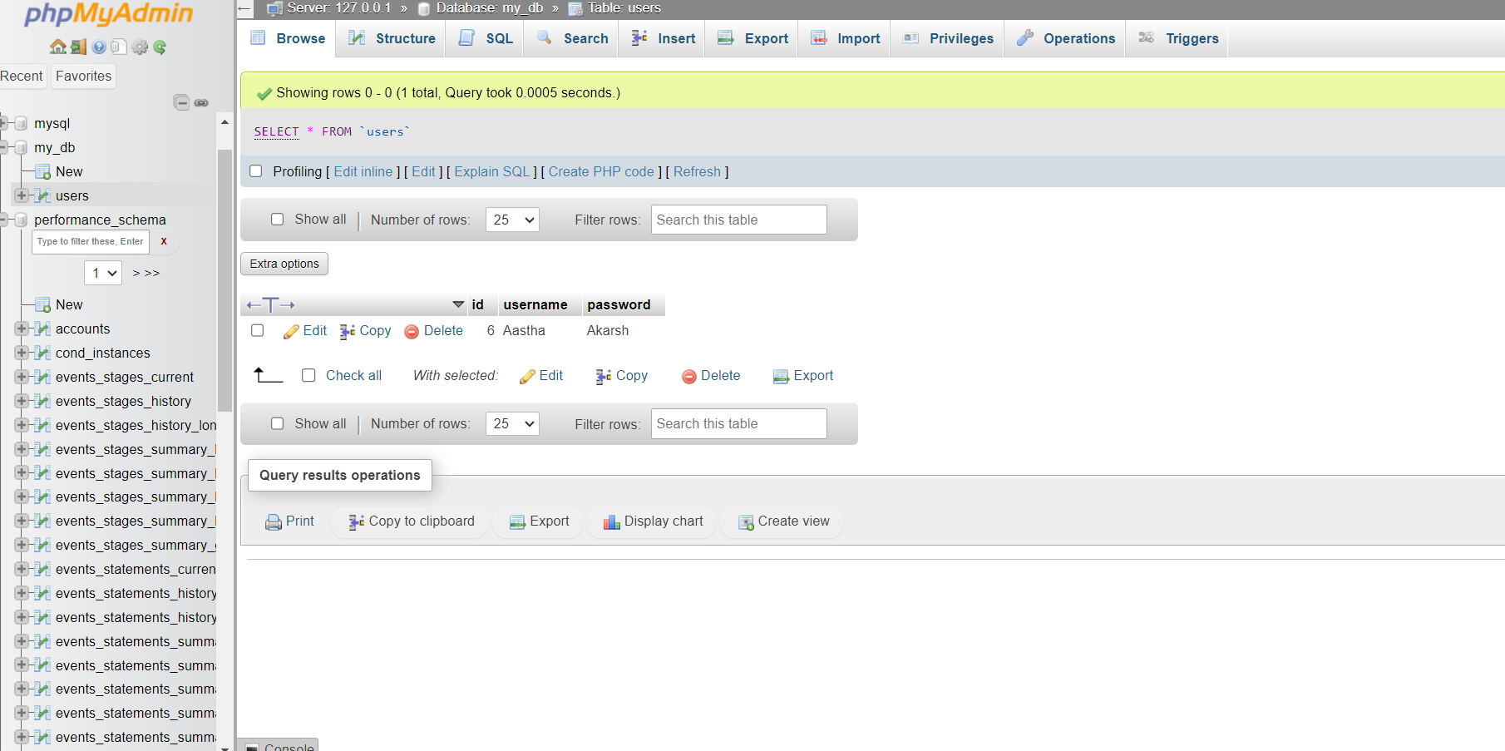
Database PHP

Slide 10
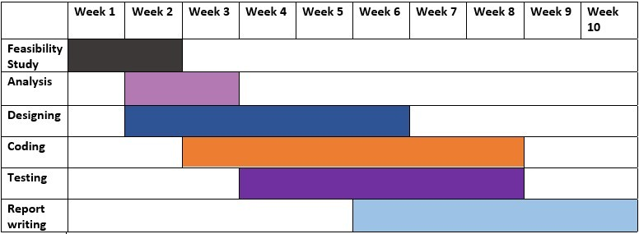
Gantt Chart(Proposed Time Duration)

Slide 11

Report Outcome
Clarity and Direction
Goal Achievement
Increased Opportunities
Professional Development
Improved Job Search Efficiency
Networking and Mentorship
Confidence and Empowerment

Slide 12

Conclusion
Clarity and Direction
Goal Achievement
Increased Opportunities
Professional Development
Improved Job Search Efficiency
Networking and Mentorship
Confidence and Empowerment

Slide 13

Thank you 😊

